Slide 1
DESIGNING A UNIFIED THREAT MANAGEMENT SYSTEM FOR HOME NETWORKS
Guided by
Dr. M. Blessy Queen Mary M.E, PH.D.
Team Members
Aswin S - 71772218102
Janardhan M - 71772218116
Praghadeesh S - 71772218138
Iyappan K - 71772218L04

Slide 2
PROBLEM IDENTIFICATION
Existing System:
  Home Routers focus on Connectivity and not Security.
  Systems use basic firewalls/antivirus, limited to Layer 3/4 filtering.
  Corporate UTM Solutions need high resources.
  UTMs depend on paid signature updates, lack of dynamic IoC feeds.
Issues in the System
  The Home Network is the New Perimeter.
  Explosive Growth with inadequate Defense.
  A dangerous vacuum in security, with users lacking technical expertise.
  Security tools are isolated and not integrated.

Slide 3
OBJECTIVES
To design a Smart Unified Threat Management System (SUTMS) for home networks.
Provide corporate-grade security to personal/home devices like laptops, mobiles, and IoT gadgets.
Develop a lightweight, cost-effective, and easy-to-deploy solution using Raspberry Pi.
Ensure multi-layered protection – Flow detection, Intrusion detection, Firewall, Anti-bot protection.
Reduce CPU/memory usage while maintaining high detection accuracy (≈99%).

Slide 4
PROPOSED SYSTEM
Smart UTM System (SUTMS) on Raspberry Pi with Ubuntu OS.
Integrated Features:
  Flow Detection – detects anomalies, protocols, optimizes IDS signatures.
  Intrusion Detection – detects & prevents malicious traffic.
  Firewall (IPtables) – dynamic anti-bot blocking.
  Additional modules: Routing Engine, Logging Engine.
  Provides real-time detection, prevention, and anomaly analysis.
  Achieves lightweight, scalable, and automated home-network security.

Slide 5
LITERATURE SURVEY
Paper | Problem/Objective | Method/Module | Key Considerations | Limitations
Intrusion Detection for IoT-enabled Smart Homes | Smart homes face frequent cyber threats due to weak device security. | ML-based intrusion detection focusing on anomaly detection. | Must be lightweight, accurate, and adaptive. | Simulation-based, dataset-dependent, may not generalize to real IoT attacks.
Phishing/Malicious URL Detection with Raspberry Pi | Home networks often fail to detect phishing URLs; need cost-effective solution. | NETBITS on Raspberry Pi using URL feature analysis & classification. | Low-cost hardware, real-time monitoring, feasible for small networks. | Focuses only on URL-based threats; Raspberry Pi has limited processing power.
Traffic Trace Artifacts from Port Mirroring | Port mirroring (SPAN) used for monitoring may distort traffic traces. | Studied artifacts like packet loss & timing distortion in switches/routers. | IDS accuracy depends on fidelity of captured traces. | Only studies port mirroring, not other capture methods; based on older hardware.
Performance of Open-source IDS in High-speed Networks | IDS like Snort, Suricata, Bro face bottlenecks in Gbps traffic environments. | Benchmarked IDS performance (throughput, packet loss, detection accuracy). | Requires multi-threading, optimized rules, hardware acceleration. | Hardware-dependent results; focus on performance, not detection improvements.

Slide 6
LITERATURE SURVEY
Paper | Problem/Objective | Method/Module | Key Considerations | Limitations
Survey on Unified Threat Management (UTM) Systems for Home Networks | Home/SoHo networks need enterprise-level security, but UTMs are built mainly for enterprises. | Surveyed UTM approaches (firewall, IDS/IPS, antivirus, anti-bot) and deployment issues. | Constraints on cost, usability, and integration with threat intelligence (STIX/TAXII). | Purely survey-based, no prototype or deployment solution.
Comprehensive Study on STIX and TAXII | Threat intelligence sharing lacks standardization. | Analyzed STIX (Structured Threat Information Expression) and TAXII (Trusted Automated Exchange of Indicator Information). | Machine-readable intel sharing, interoperability, importance for adaptive firewalls/IDS. | Machine-readable intel sharing, interoperability, importance for adaptive firewalls/IDS.
IoT Device Classification using Machine Learning | Classify IoT devices to detect anomalies or threats. | ML-based classification models with feature extraction from device behavior. | Accurate classification prevents misuse; requires good training and preprocessing. | Relies on labeled datasets; models may drift with new devices or attack types.
Automatic Device Classification using Arduino Platform | Identify/classify IoT devices for stronger network security. | Device identification algorithms using Arduino hardware. Real-time classification based on communication patterns. | Efficient resource use, adaptability across device types. | Limited processing capacity, risk of misclassification in noisy networks.

Slide 7
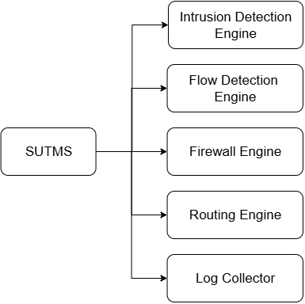
METHODOLOGY – CORE MODULES
Flow Detection Engine ( NTOP )
  Identify Traffic Patterns.
  Detects anomalies.
  Provides data for signature optimization.
Intrusion Detection Engine ( Suricata )
  Matches traffic to known attack patterns.
  Can operate in IDS or IPS mode.
Firewall ( Iptables + IoC feeds via STIX/TAXII )
  Blocks malicious IPs dynamically.
  Enhances anti-bot protection.

Slide 8
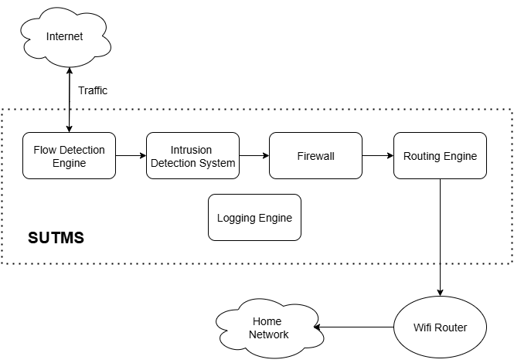
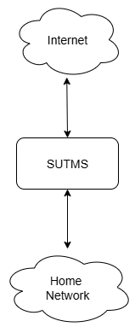
METHODOLOGY – SYSTEM FLOW
High Level Flow
Detailed Flow

Slide 9
RESOURCES REQUIRED
Hardware: Raspberry Pi 3
OS : Ubuntu 22.04
Core software: Ntopng, Suricata, iptables
Threat Feeds: STIX/TAXII (Anomali, OTX) for IoCs
Dataset: CICIDS2017 used for testing and validation
Testing Environment: Home network with multiple devices (PCs, IoT, mobile)

Slide 10
CHALLENGES & RISK FACTORS
Hardware Limits : Limited processing capacity can reduce detection speed and accuracy
Scalability : Higher traffic and devices strain system performance and resources
Integration : Multiple feeds and tools make management and correlation difficult
Detection Errors : Incorrect alerts can either overwhelm or miss real threats
Updates : Continuous tuning needed to stay ahead of evolving threats
Misconfiguration : Human errors or outdated settings weaken security posture
Single Point Failure : Centralized design can lead to complete outage if compromised
Latency : Security checks may slow down or disrupt normal network performance

Slide 11
OUTCOMES / DELIVERABLES
System: Affordable SUTMS running on Raspberry Pi
Scripts: Auto-tuning of IDS rules and IoC ingestion tools
Configuration: Pre-set firewall and IDS for easy use
Accuracy: Around 99% detection with optimized setup
Efficiency: 55% less memory usage, stable CPU load
Benefit: Strong protection for home and SOHO networks

Slide 12
THANK YOU

